Slide 1
CEF 440: INTERNET PROGRAMMING AND MOBILE PROGRAMMING PRESENTATION ON MOBILE APP DEVELOPMENT TASK 1
Presented By:
NAMES | MATRICULES
QUINUEL TABOT NDIP-AGBOR | FE21A300
SIRRI THERESIA ANYE | FE21A306
CHE BLAISE NJI | FE21A157
NGONCHI RAMATOU YOLAND | FE21A260
LIMA CHARLES | FE21A225

Slide 2
OUTLINE
1) INTRODUCTION
2) REVIEW OF TYPES OF MOBILE APPLICATION
3) REVIEW AND COMPARISONS OF SOME MOBILE APP PROGRAMMING LANGUAGES
4) REVIEW AND COMPARE SOME POPULAR MOBILE APP DEVELOPMENT FRAMEWORKS BASED ON KEY FEATURES
5) STUDY OF MOBILE APPLICATION ARCHITECTURES AND DESIGN PATTERNS
6) COLLECTING AND ANALYSING USER REQUIREMENTS FOR A MOBILE APPLICATION (REQUIREMENT ENGINEERING)
7) ESTIMATING MOBILE APP DEVELOPMENT COST
8) CONCLUSION
9) REFERENCE

Slide 3
I. INTRODUCTION
Mobile Application Development: Reviewing Major Types, Programming Languages, Frameworks, Architectures, and Best Practices
we will explore the exciting world of mobile application development. We will review the major types of mobile applications, discuss popular programming languages and frameworks used to build them, delve into mobile application architectures and design patterns, and explore best practices for collecting and analyzing user requirements, estimating development costs, and ensuring a successful mobile app development journey.

Slide 4
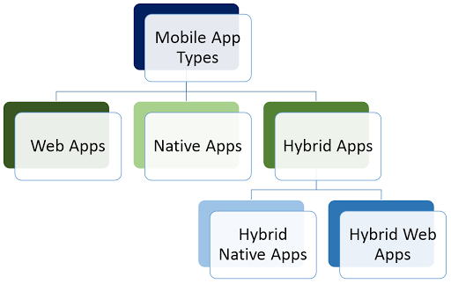

Slide 5
II. REVIEW OF TYPES OF MOBILE APPLICATION
Mobile Applications can be broadly categorized into three main types: native apps, progressive web apps (PWAs), and hybrid apps. Each type has its own advantages and disadvantages, and the choice of which type to use depends on the specific needs of the project.
Native Apps
Designed specifically for a particular platform (iOS, Android, etc.)
Offer the best performance and user experience
Progressive Web Apps (PWAs)
Web applications that can be installed on a mobile device
Offer a near-native experience and work offline
Hybrid Apps
A combination of web technologies and native code
Offer a balance between cross-platform development and performance

Slide 6
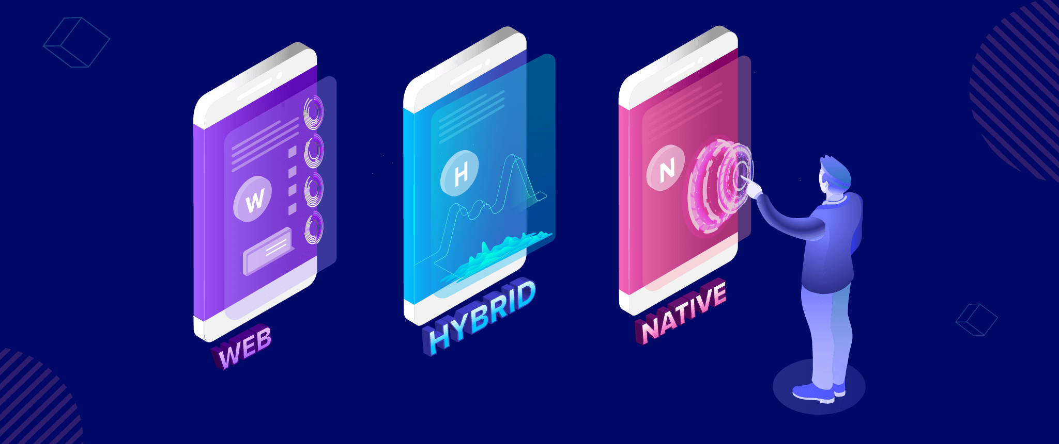

Slide 7
III. REVIEW AND COMPARISONS OF SOME MOBILE APP PROGRAMMING LANGUAGES
The choice of programming language for mobile app development depends on the target platform and the specific requirements of the project. Here's a brief overview of some popular options:
Java: Widely used for Android app development, known for its platform-independence and rich ecosystem of libraries and tools.
Kotlin: A modern language gaining popularity for Android development, offering features like null safety and concise syntax.

Slide 8
Swift: Apple's preferred language for iOS and macOS development, known for its safety features, performance, and ease of learning.
Objective-C: A traditional language used for iOS development, often used in conjunction with Swift for existing projects.
Python: A versatile language used for web development, data science, and automation tasks, also gaining traction in mobile app development, particularly for prototyping.
Dart: Google's language used with the Flutter framework for building cross-platform mobile apps, known for its high performance and hot reload feature.
HTML, CSS, and JavaScript: The building blocks of web development, also used to create PWAs that offer a mobile-like experience.

Slide 9
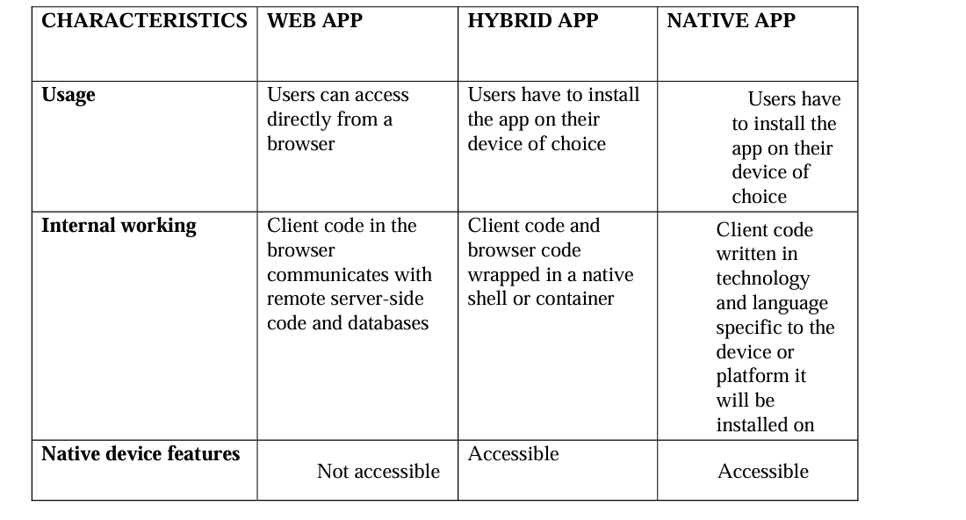

Slide 10
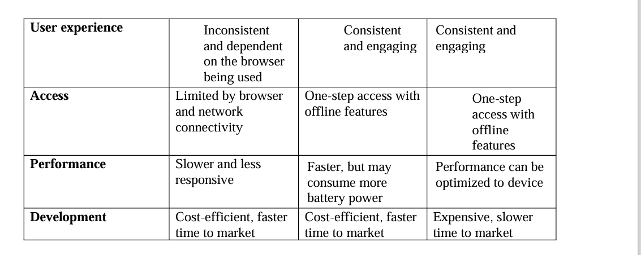

Slide 11
IV. REVIEW AND COMPARE SOME POPULAR MOBILE APP DEVELOPMENT FRAMEWORKS BASED ON KEY FEATURES
3.1.1. Xamarin
- Language: C#
- Performance: Near-native performance due to compilation to native code.
-Cost & Time to Market: Generally cost-effective and can speed up development time.
- UX & UI: Supports building native user interfaces for iOS and Android.
- Complexity: Learning curve for C# and platform-specific APIs.
- Community Support: Strong community support from Microsoft and developers.
- Usage: Suitable for cross-platform development targeting iOS, Android, and Windows.

Slide 12
Complexity: Dart might have a learning curve for developers new to the language.
- Community Support: Growing community with support from Google and the developer community.
- Usage: Supports cross-platform develop
3.1.2. React Native - Language: JavaScript
- Performance: Good performance but may have some overhead due to bridge communication.
- Cost & Time to Market: Cost-effective and rapid development compared to building separate native apps.
UX & UI: Utilizes native components for a native-like user experience.
Complexity: Relatively low complexity if familiar with JavaScript.
Community Support: Large community support with active contributions.
Usage: Ideal for developing cross-platform apps for iOS, Android, and even web applications.

Slide 13
3.1.3. Flutter
- Language: Dart
- Performance: High performance with a compiled-to-native approach.
- Cost & Time to Market: Cost-effective and can reduce development time with hot reload feature.
- UX & UI: Offers customizable UI elements through its widget system, facilitating stunning designs. ment for iOS, Android, Web, and even Desktop applications.
3.2. Comparison:
- Language: C# for Xamarin, JavaScript for React Native, Dart for Flutter.
Performance: Flutter offers high performance due to compiled native code, while React Native and Xamarin offer good performance.
- Cost & Time to Market: All three frameworks are cost-effective options that can accelerate time to market compared to native app development.
- UX & UI: Flutter provides a highly customizable UI, while React Native and Xamarin offer native-like user interfaces.
- Complexity: Xamarin may have a steeper learning curve due to platform-specific APIs, while React Native and Flutter are more developer-friendly.
- Community Support: React Native has a large community, followed by Flutter, while Xamarin has a strong backing from Microsoft.

Slide 14
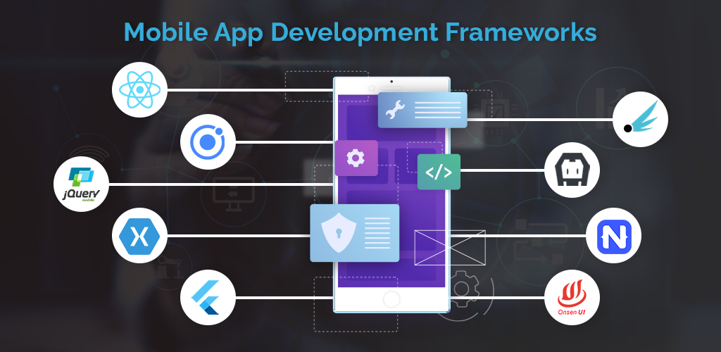

Slide 15
V. STUDY OF MOBILE APPLICATION ARCHITECTURES AND DESIGN PATTERNS
1) Model-View-Controller (MVC): This is a widely used architecture that separates the application into three distinct layers:
Model: Handles data and business logic.
View: Represents the user interface.
Controller: Processes user interactions and updates the model and view accordingly.
Benefits of MVC:
Modular structure for easier development and maintenance.
Improved code reusability.
Clear separation of concerns.

Slide 16
2) Model-View-Presenter (MVP): Similar to MVC, but with a more defined separation between the view and presenter. The presenter acts as an intermediary between the view and the model, handling business logic and data formatting for the view.
Benefits of MVP:
Improved testability due to a clear separation of concerns.
Easier to maintain the view layer.

Slide 17
3) Model-View-ViewModel (MVVM): This architecture introduces a ViewModel layer that sits between the Model and the View. The ViewModel manages the data and presentation logic, simplifying the View and improving testability.
Benefits of MVVM:
Enhanced separation of concerns compared to MVP.
Improved data binding and testability.

Slide 18
Design Patterns
Design patterns are reusable solutions to common software development problems. They provide a proven approach to implementing functionalities within your mobile app. Here are some commonly used design patterns in mobile app development:
Singleton Pattern
Observer Pattern
Factory Pattern
Adapter Pattern
Decorator Pattern
Strategy Pattern

Slide 19
VI. COLLECTING AND ANALYSING USER REQUIREMENTS FOR A MOBILE APPLICATION (REQUIREMENT ENGINEERING
Understanding user needs is paramount to the success of any mobile application. By collecting and analyzing user requirements, we ensure that the app is designed to address their problems and provide a valuable user experience. Here, we will explore various techniques for gathering and analyzing user requirements.
1) User Requirement Collection Techniques:
Stakeholder Interviews: Conducting structured interviews with key stakeholders like clients, users, and domain experts to gather insights into their needs, preferences, and expectations.
Surveys and Questionnaires: Distributing surveys to a targeted audience to collect quantitative data on user demographics, pain points, and feature preferences.

Slide 20
2) User Requirement Analysis
Prioritization of Requirements:
- Description: Rank requirements based on their importance and impact on the overall success of the app.
- Approach: Use techniques like MoSCoW (Must have, should have, could have, Won’t have) to prioritize features.
Requirement Documentation:
- Description: Document user requirements in a clear, structured manner to serve as a reference during the development process.
- Approach: Create user stories, use cases, and requirements specifications detailing functional and non-functional requirements.

Slide 21
VII. ESTIMATING MOBILE APP DEVELOPMENT COST
Here are some steps and factors to consider when estimating the cost of developing a mobile app:
1. Define Project Scope and Requirements
2. Identify Development Costs
3. Consider Design and Asset Creation Costs

Slide 22
4. Account for Testing and Quality Assurance - Testing Devices
5. Include Deployment and Maintenance Costs - App Store Fees
6. Additional Factors to Consider - Project Management
7. Cost Estimation Techniques - Bottom-Up Estimation
8. Use Cost Estimation Tools

Slide 23
VIII. CONCLUSION
By carefully defining the project scope, identifying development costs, considering design and testing needs, factoring in deployment and maintenance costs, and using estimation techniques and tools, you can create a comprehensive estimate for the cost of mobile app development. Regularly reviewing and adjusting the estimate as the project progresses will help ensure that the budget aligns with the project requirements and goals.

Slide 24
IX. REFERENCES
IBM MOBILE DEVELOPMENT: https://www.ibm.com/topics/mobile-application-development
Wikipedia: https://en.wikipedia.org/wiki/Mobile_app_development
Android developers: https://developer.android.com/
YouTube: https://www.youtube.com/watch?v=7nQsQ0rvYqQ
Dribble: https://dribbble.com/tags/best-mobile-app

